Slide 1
Transformers Architecture
Three types:
Encoder - understands context (BERT, RoBERTa)
Decoder - generates text (GPT, GPT-2)
Encoder-Decoder - translation, summarization (T5, BART)
Transfer Learning:
Pre-trained on billions of texts
Fine-tune for specific task
pipeline() - ready-to-use pipelines

Slide 2
Tokenization Types
Type | Example | Pros/Cons
Word-based | "playing" → ["playing"] | Huge vocab, OOV problem
Character | "cat" → ["c","a","t"] | Small vocab, loses meaning
Subword (BPE) | "playing" → ["play","ing"] | Balance, no OOV

Slide 3
Text Preprocessing
Pipeline steps:
Lowercasing - "HELLO" → "hello"
Tokenization - split into tokensa
Stopword removal - remove "the", "is", "a"
Stemming - playing → play (suffix cutting)
Lemmatization - better → good (dictionary form)
Vectorization methods:
Bag of Words (BoW) - word frequency
TF-IDF - importance in document vs corpus
Word Embeddings (Word2Vec, GloVe) - semantic vectors

Slide 4
TF-IDF Formula
TF-IDF = TF(t,d) × IDF(t)
TF = (word count in document) / (total words in document)
IDF = log(total documents / documents containing word)
Key idea:
High TF-IDF = word is important for this document
Rare words get higher weight
Common words ("the", "is") get low weight

Slide 5
Named entity recognition(NER)
Entity types:
PERSON - people names
ORG - organizations
GPE - countries, cities
DATE - dates
MONEY - monetary values

Slide 6
PRACTICAL PROJECT
Goal: Extract sentiment and key themes from customer feedback
Dataset: 24,783 tweets (CrowdFlower labeled)
offensive_language: 77.4%
neither: 16.8%
hate_speech: 5.8%
Success Criteria:
Text preprocessing (lowercasing, stopwords, tokenization)
Sentiment analysis using pre-trained models
Classify positive vs negative feedback
Identify 3-5 key themes using TF-IDF or LDA

Slide 7
Preprocessing Pipeline
Steps applied:
Lowercase
URL removal
Mention removal (@user)
HTML decode (& → and)
Special character removal
Tokenization (whitespace split)
Stopword removal (sklearn + 40 custom)
Basic stemming (-ing, -ed removal)
Result: 24,783 → 24,778 samples (5 empty removed)

Slide 8
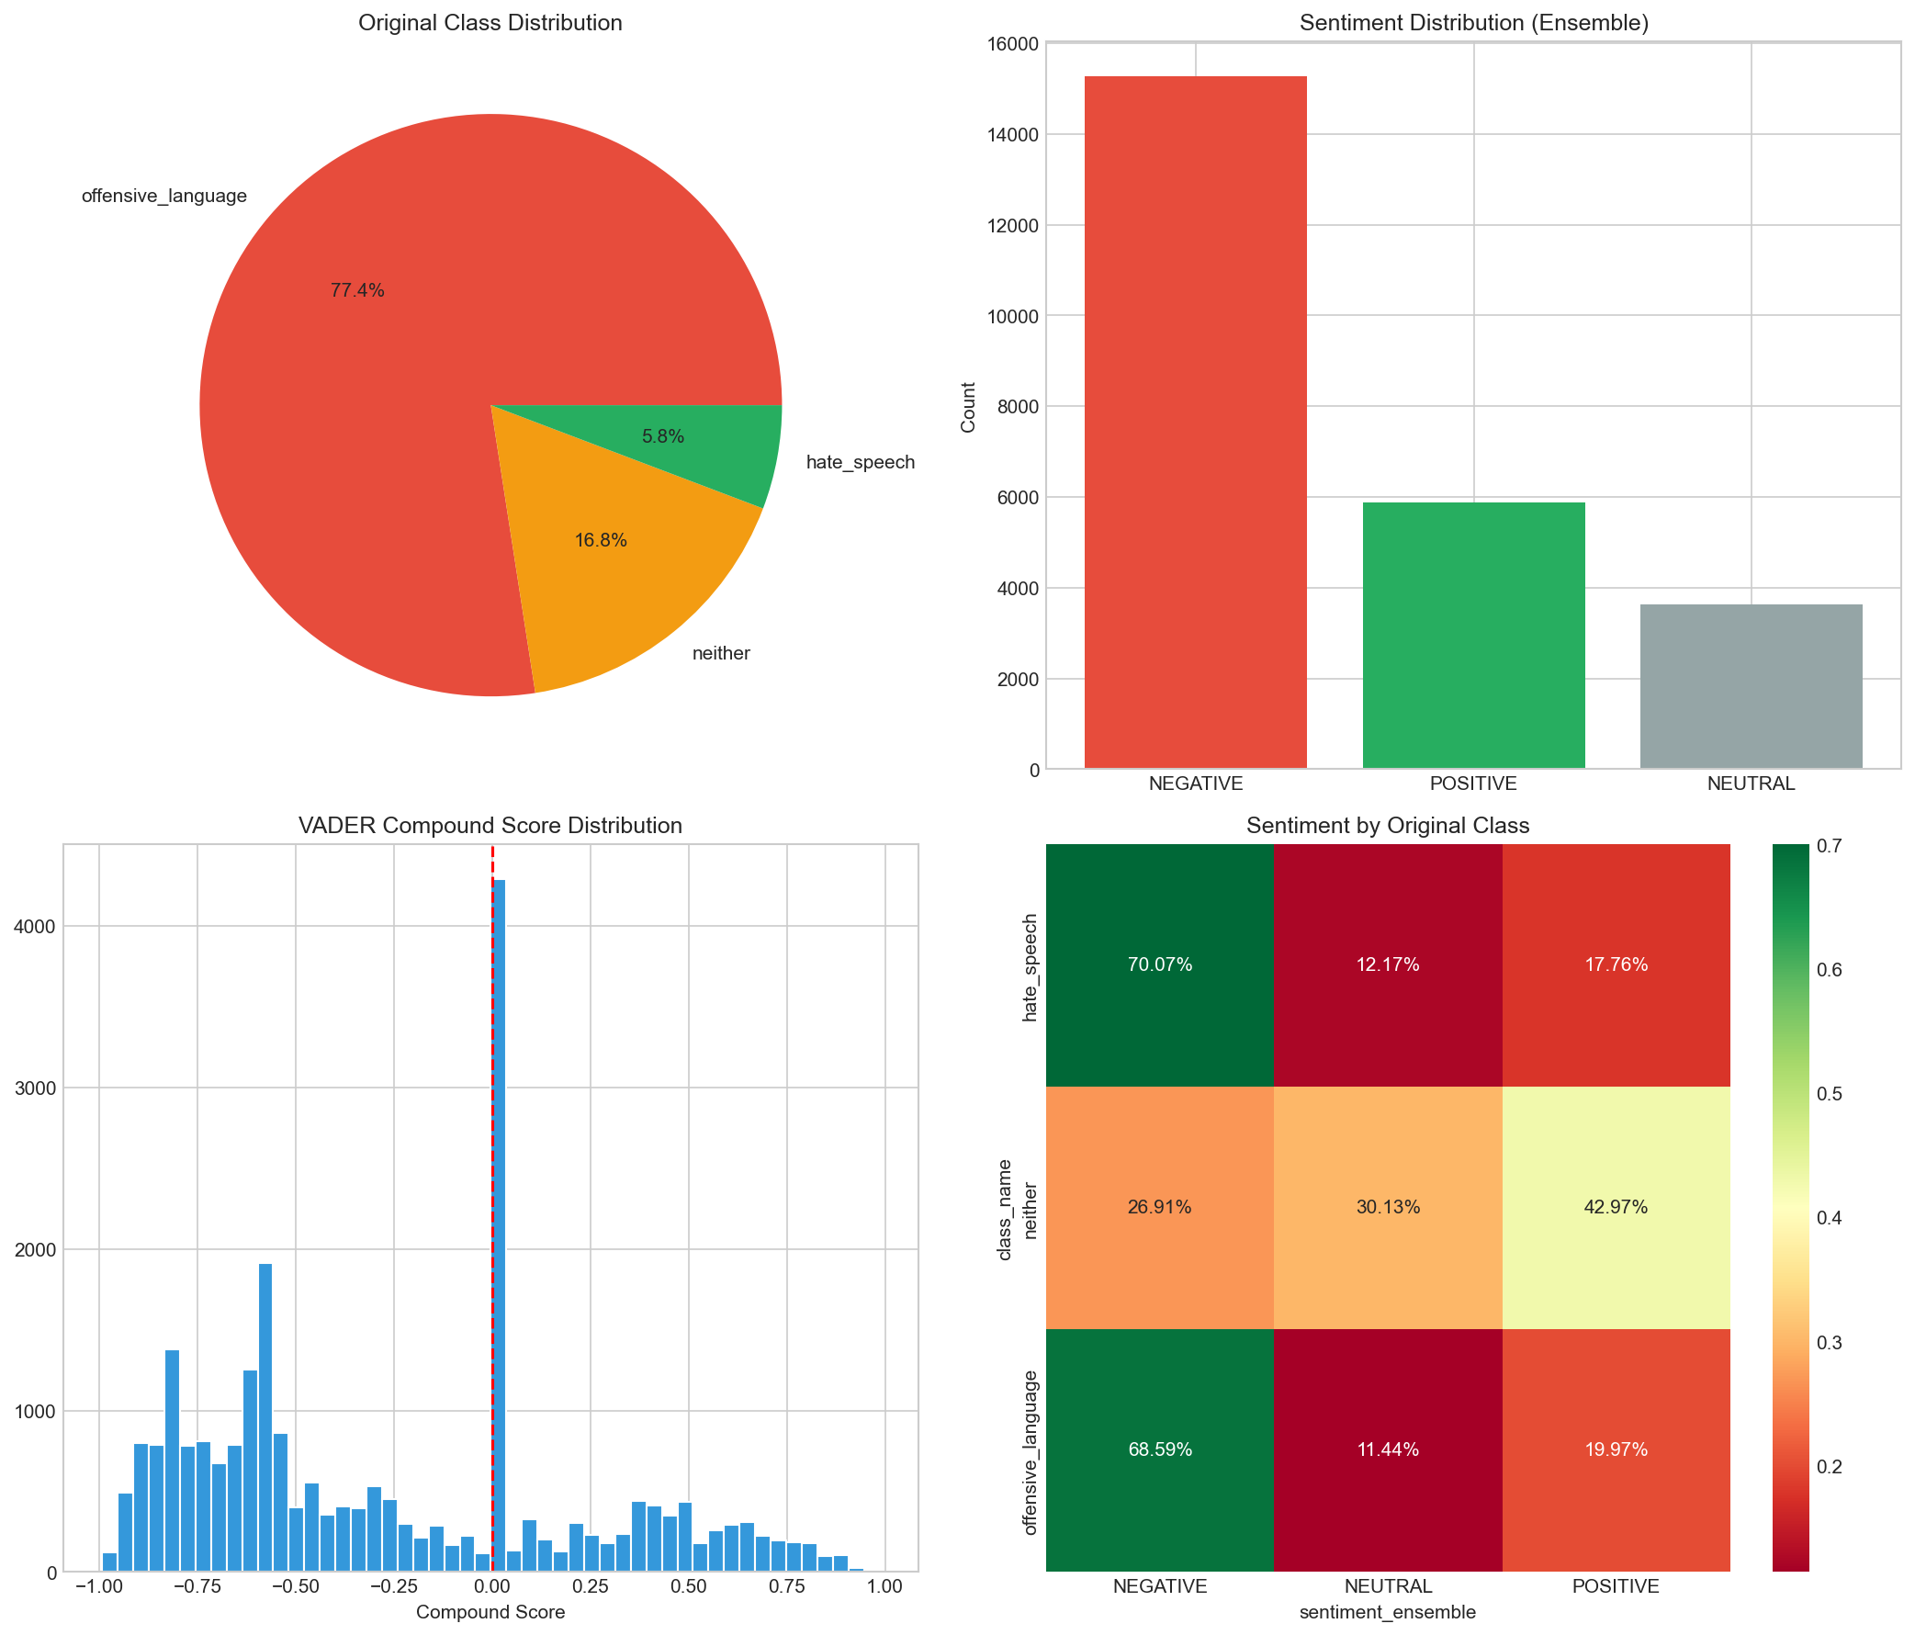
Sentiment Analysis Methods
Ensemble logic:
If both agree → use that
If one is NEUTRAL → use the other
Otherwise → prefer VADER (social media)
Final result:
NEGATIVE: 61.7% (15,282)
POSITIVE: 23.7% (5,874)
NEUTRAL: 14.6% (3,622)

Slide 9
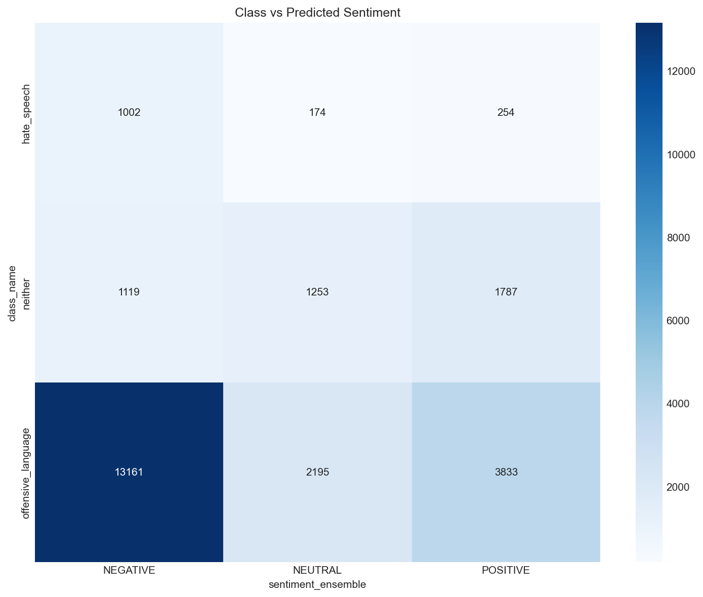
Sentiment validation
Comparison with ground truth:
Class | NEGATIVE | NEUTRAL | POSITIVE
hate_speech | 70.07% | 12.17% | 17.76%
offensive_language | 68.59% | 11.44% | 19.97%
neither | 26.91% | 30.13% | 42.97%
Conclusion:
Hate speech correctly identified as NEGATIVE (70%)
Offensive language also NEGATIVE (68.6%)
Neither correctly shifted to POSITIVE (43%)

Slide 10
TF-IDF Vectorization
Top-10 TF-IDF terms: bitch, bitches, hoes, pussy, hoe, fuck, trash, ass, don, shit

Slide 11
LDA Topic Modeling
What is LDA:
Latent Dirichlet Allocation
Unsupervised method
Finds hidden topics in document collection
Each document = mixture of topics
Each topic = distribution over words

Slide 12
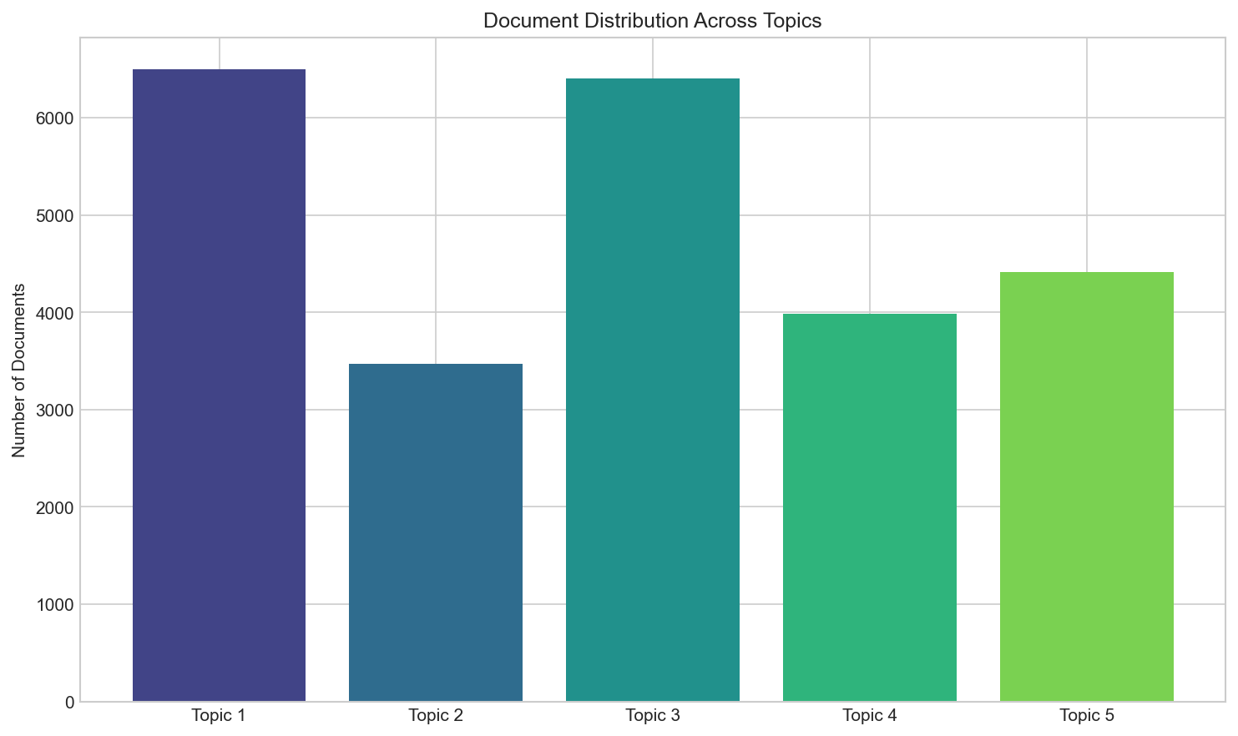
Discovered Topics
Topic | Top Keywords
Topic 1 | hoes, hoe, bitches, niggas, don
Topic 2 | bitch, ass, said, day, yankees
Topic 3 | bitch, nigga, ain, bitches, love
Topic 4 | bitch, fuck, bitches, don, pussy
Topic 5 | pussy, trash, good, faggot, retard

Slide 13
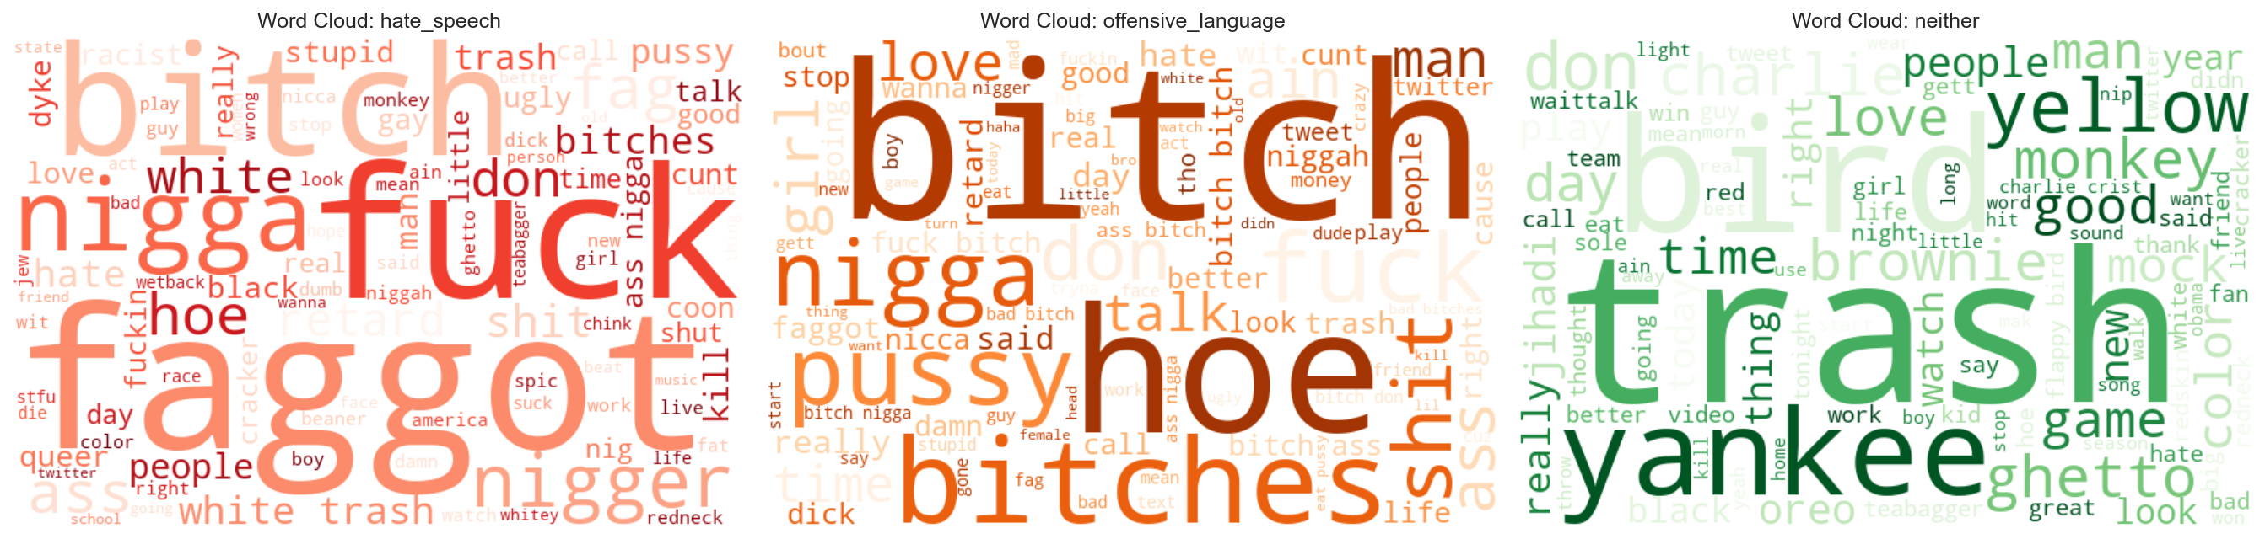
Word Clouds by Class
Visual representation of most frequent terms per class:
hate_speech - red colormap
offensive_language - orange colormap
neither - green colormap

Slide 14
Results Summary
Metric | Value
Dataset size | 24,778
TF-IDF features | 2,000
LDA topics | 5
NEGATIVE sentiment | 61.7%
Hate → NEGATIVE | 70%
VADER mean compound | -0.263

